Slide 1
Web automation using Selenium
Vinay H A
Sep 21st & Sep 22nd , 2022

Slide 2

Why automate?
Notes:
Slow and steady wins the race!!!.
Proverb got updated – “Fast & steady wins the race!!” . Faster, reliable & diverse products sells more!!.
Companies are trying to meet the growing expectation of the consumers
- Loading a video , uploading a video

Slide 3
What do you automate?
Is it a repetitive task performed regularly?
Is it a process that becomes a bottleneck or holds up other parts of your workflow?
Has it stayed the same for some time and undergoes minimal change?
Is it a process you can easily define and outline steps to completion?

Slide 4
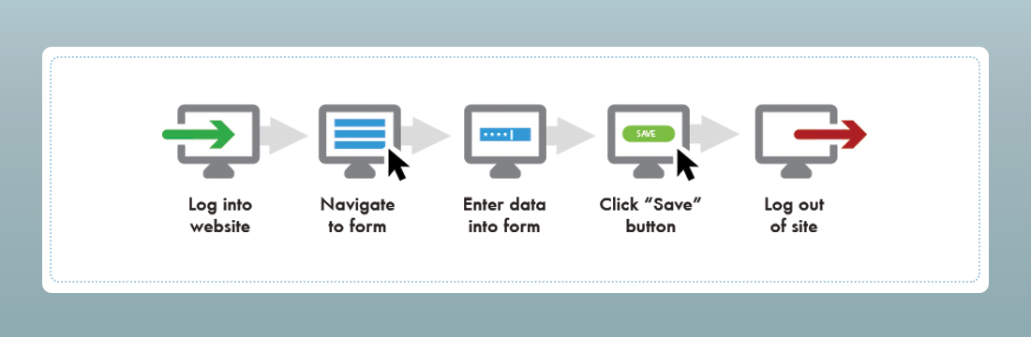
About Web Application Automation
Notes:
Web application provides required interface to

Slide 5
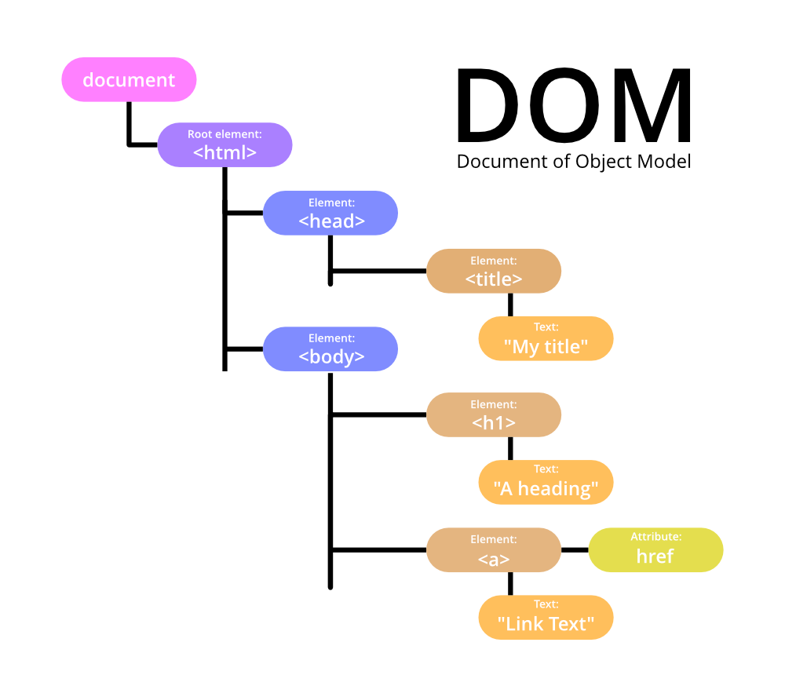
Most used web objects and its attributes
WebElementName | HTML-Tag | Critical Properties | Optional Properties
TextBox | Input | type='text' | name,value,class
Password | Input | type='password' | name,value,class
Image | Img | src='<imagefilelocation>' | height & width
link | a | href='<LinkLooction>' | onClick
Button | Input | type='submit' | name,value,class
Radiobutton | Input | type='radio' | name,value,class
CheckBox | Input | type='checkbox' | name,value,class
DropDownList | select | name='ListName' | option is the tag for subitems
Hidden | Input | type='hidden' | name,value,class

Slide 6
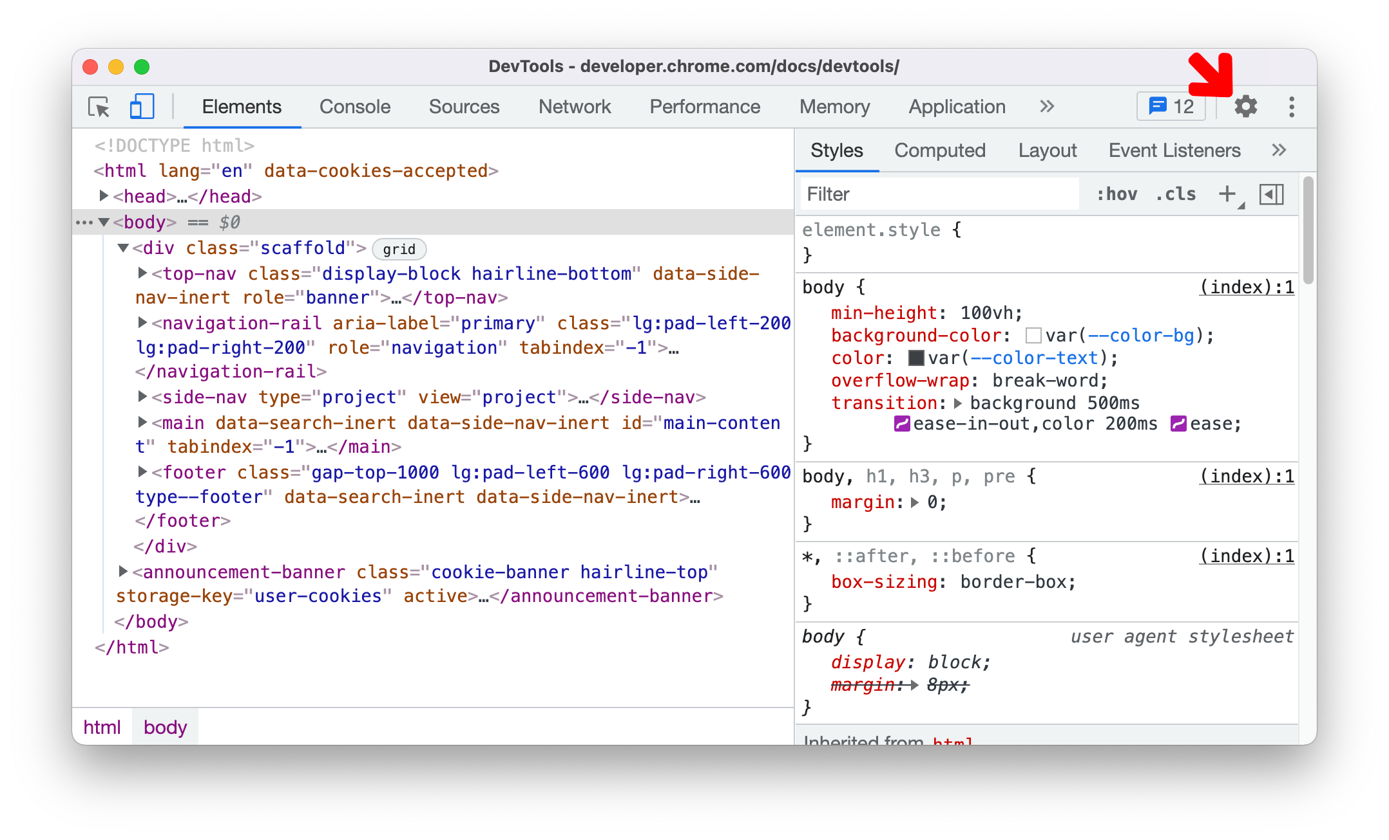
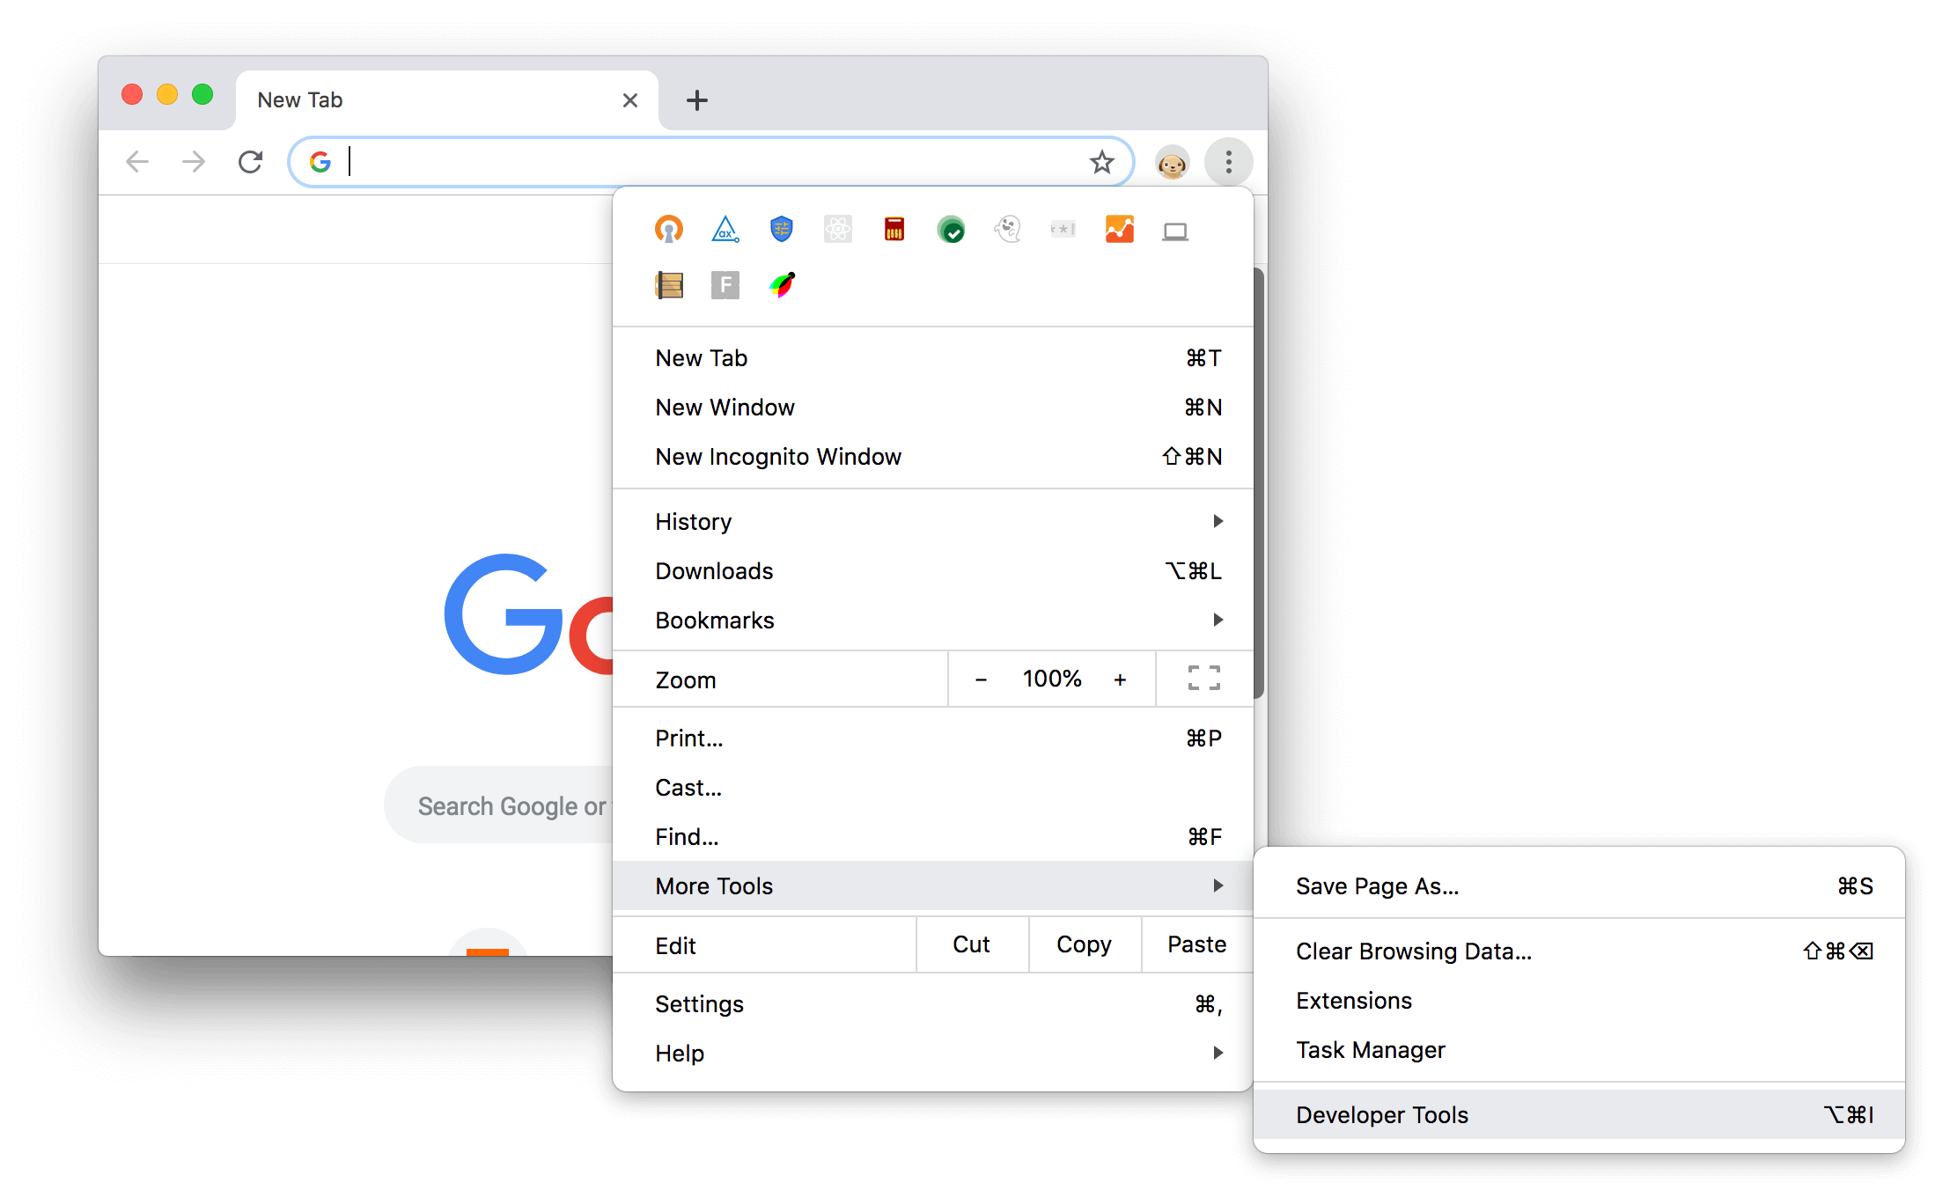
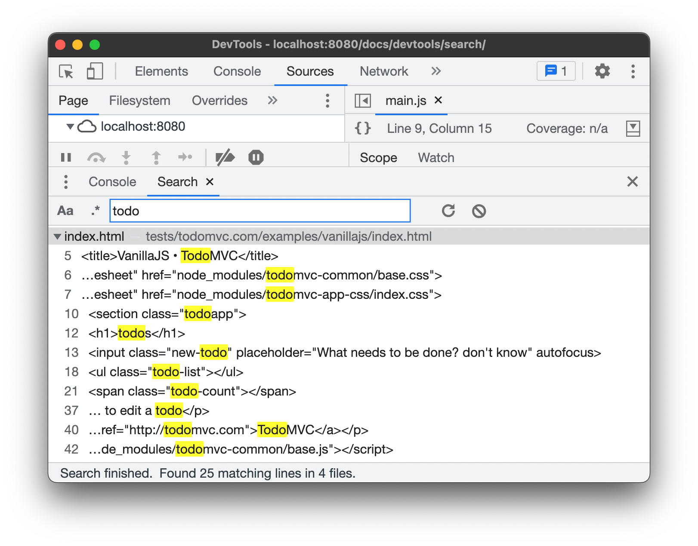
Chrome developer tool

Slide 7
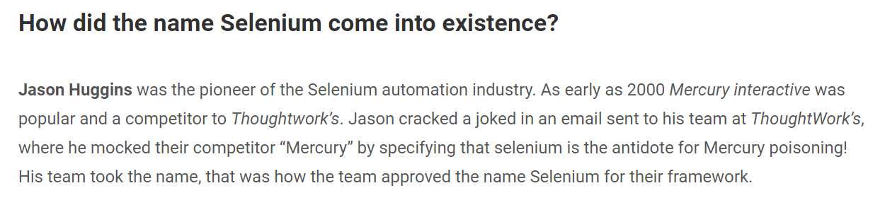

Slide 8
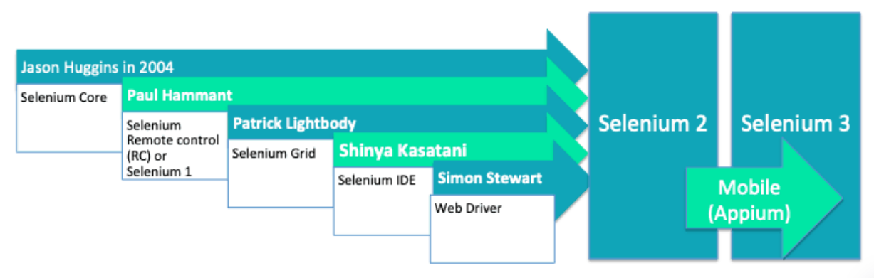
Selenium 4

Slide 9


Slide 10
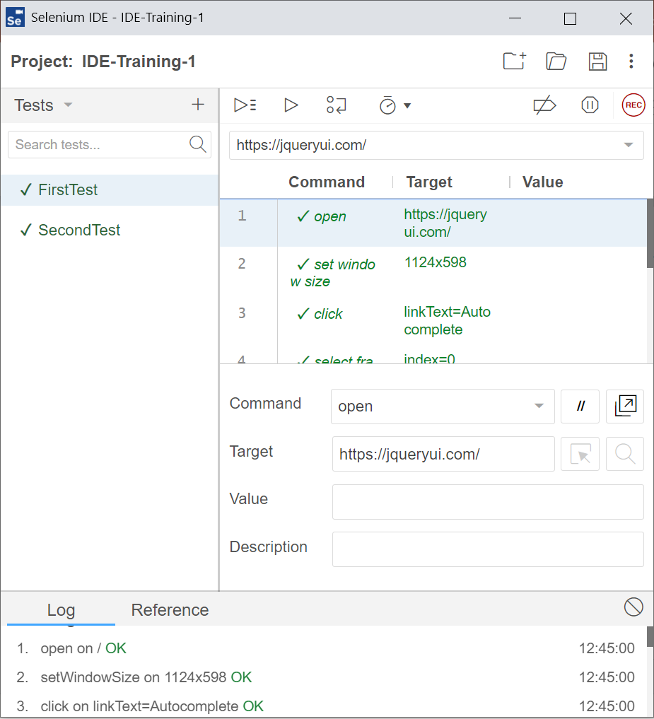
Selenium IDE
Open-source record and playback test automation for the web
You can create quick bug reproduction scripts
It requires no additional setup other than installing the extension on your browser
a Chrome, Firefox and Edge add-on/extension

Slide 11
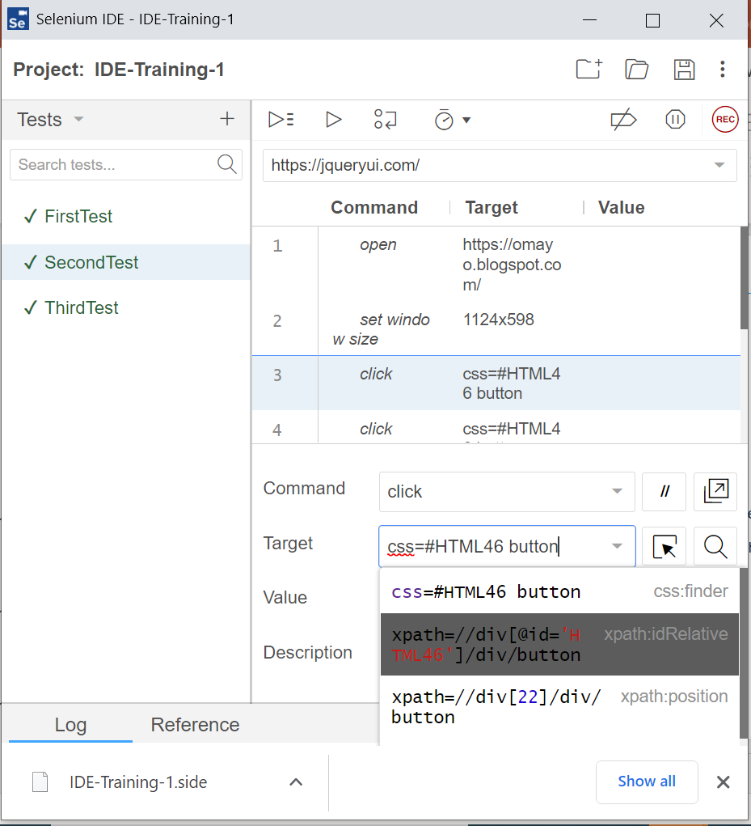
Selenium IDE key features
Resilient Tests
Selenium IDE records multiple locators for each element it interacts with. If one locator fails during playback, the others will be tried until one is successful.
Test Case Reuse
With the run command, you can re-use one test case inside of another (e.g., allowing you to re-use your login logic in multiple places throughout a suite).
Control Flow
Selenium IDE ships with an extensive control flow structure, with available commands like if, while and times.

Slide 12

Selenium Web driver
If you want to create robust regression automation suites and tests, scale and distribute scripts across many environments, then you want to use Selenium WebDriver

Slide 13
About Web Driver
Web Driver is designed as a simple and more concise programming interface.
The driver is the component responsible for delegating down to the browser and handles communication to and from Selenium and the browser.
This separation is part of a conscious effort to have browser vendors take responsibility for the implementation for their browsers.

Slide 14
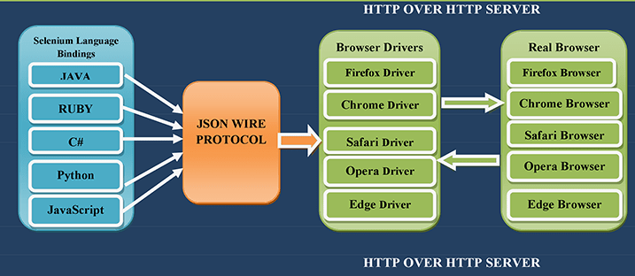
Selenium Web Driver Architecture

Slide 15
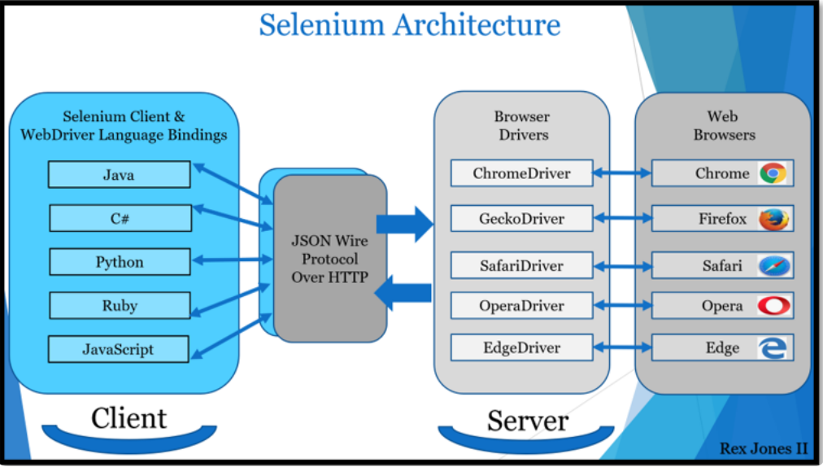
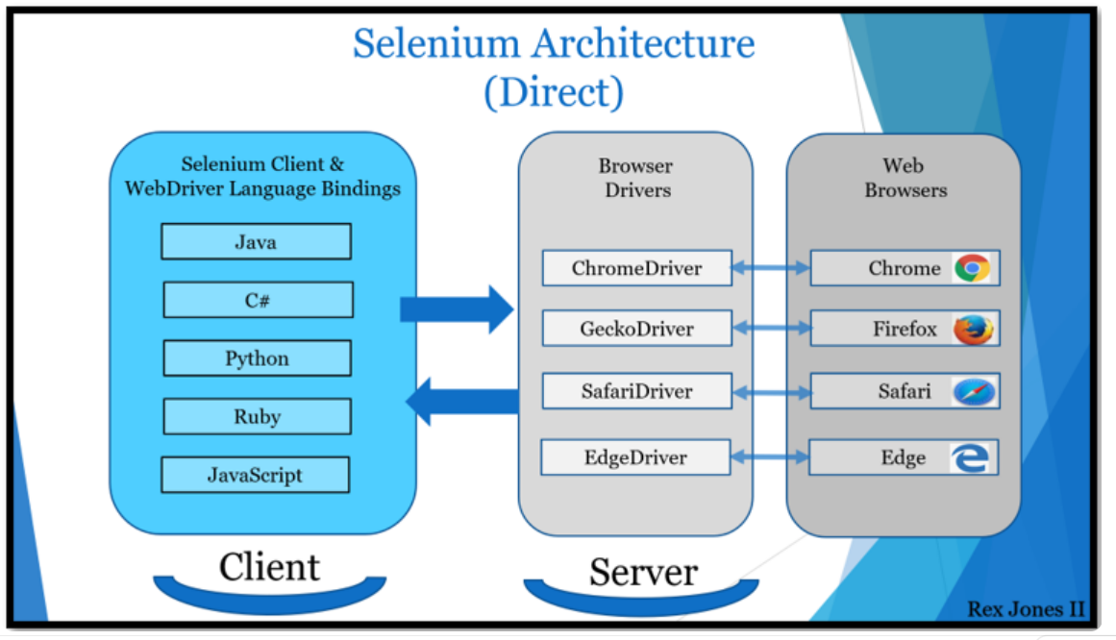
Selenium 3 → Selenium 4

Slide 16
Selenium Web Driver installation
Pre-requisite:
Python 3.10.x or above
pip3.10.exe install selenium
Download & Install PyCharm ( Community version)
https://www.jetbrains.com/pycharm/download/download-thanks.html?platform=windows&code=PCC

Slide 17
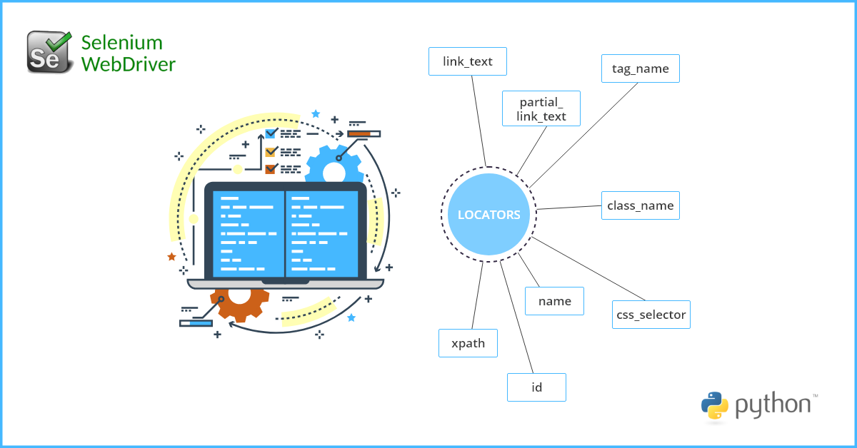
Locators

Slide 18
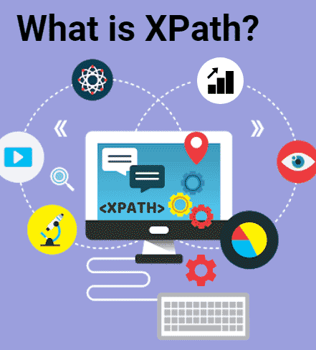
Xpath:
XPath is a language for finding information in an XML document.
XPath is a syntax for defining parts of an XML document
XPath uses path expressions to navigate in XML documents
XPath contains a library of standard functions

Slide 19
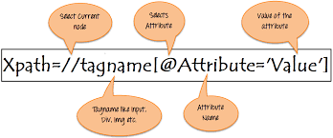
Path Expressions:
Expression | Description
nodename | Selects all nodes with the name "nodename"
/ | Selects from the root node
// | Selects nodes in the document from the current node that match the selection no matter where they are
. | Selects the current node
.. | Selects the parent of the current node
@ | Selects attributes

Slide 20
Xpath Example:
XPath: //button[starts-with(@id, 'continue-')]
XPath: //input[contains(@class, 'suggest')]
XPath= (//input[@type='checkbox'])[last()]
Xpath= /bookstore/book[1]/title
http://automationtricks.blogspot.in/2010/09/how-to-use-functions-in-xpath-in.html

Slide 21
Path Expression Examples:
Path Expression | Result
/bookstore/book[1] | Selects the first book element that is the child of the bookstore element.Note: In IE 5,6,7,8,9 first node is[0], but according to W3C, it is [1]. To solve this problem in IE, set the SelectionLanguage to XPath: In JavaScript: xml.setProperty("SelectionLanguage","XPath");
/bookstore/book[last()] | Selects the last book element that is the child of the bookstore element
/bookstore/book[last()-1] | Selects the last but one book element that is the child of the bookstore element
/bookstore/book[position()<3] | Selects the first two book elements that are children of the bookstore element
//title[@lang] | Selects all the title elements that have an attribute named lang
//title[@lang='en'] | Selects all the title elements that have an attribute named lang with a value of 'en'
/bookstore/book[price>35.00] | Selects all the book elements of the bookstore element that have a price element with a value greater than 35.00
/bookstore/book[price>35.00]/title | Selects all the title elements of the book elements of the bookstore element that have a price element with a value greater than 35.00

Slide 22
Practice session
Launch - https://jqueryui.com/
Click link – Autocomplete
Enter text – MitelCloud
Close the driver

Slide 23

Selenium Grid
Want to run tests in parallel across multiple machines? Then, Grid is for you.

Slide 24
Selenium Grid
Provide an easy way to run tests in parallel on multiple machines
Allow testing on different browser versions
Enable cross platform testing

Slide 25
Selenium Grid
Standalone
Hub/Node
Distributed

Slide 26
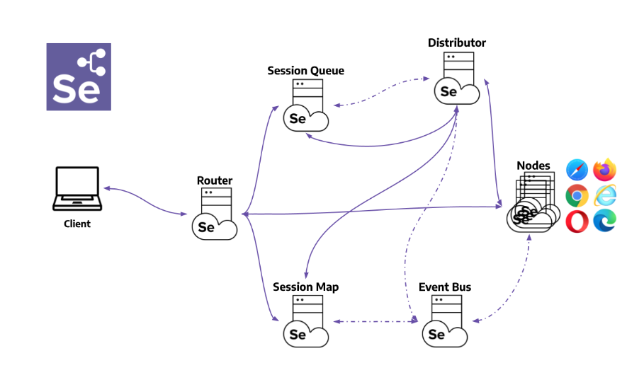
Selenium 4.0 : Distributed Grid components

Slide 27
Practice session
Distributed Selenium Grid

Slide 28
Q & A

